Slide 1






PERSONAL VOICE ASSISTANT
FOR VISUALLY IMPAIRED
Presented by Mayank Dhyani
Roll No.: 76
Section: I2
Course: B.Tech (3rd sem)

Slide 2
Problem Statement and Motivation:
Visually impaired individuals encounter significant obstacles when using technology, as most traditional computing interfaces are designed primarily for sighted users. This creates barriers that make essential tasks—such as opening files, searching the internet, and managing schedules—difficult or even impossible. The absence of accessible technology can lead to feelings of frustration and helplessness.
The motivation for creating a voice-activated personal assistant comes from a desire to make technology accessible and inclusive, empowering visually impaired users to control their devices using voice commands.

Slide 3


TOOLS & TECHNOLOGIES
Python
Version : 3.10.0
VS Code
Version : 1.95.3
SYSTEM REQUIREMENTS
OS : Windows 7 or above
RAM : 8GB or above
Hard Drive : 512 GB SSD/HDD
Processor : Intel i3 or above

Slide 4

Dataflow Diagram:
Voice
Personal
Voice
Assistant
Action
Speech to
text
User
Computer
Response
Voice Output
Text to speech

Slide 5
Working of the Model:
User
Microphone
Computer
Google API
Open Personal Assistant
Accessing G-API
Voice response
Start Mic
Wait until user speak
Convert Audio to Text
Receive data
Match text with action
Perform action
Voice/text Response

Slide 6
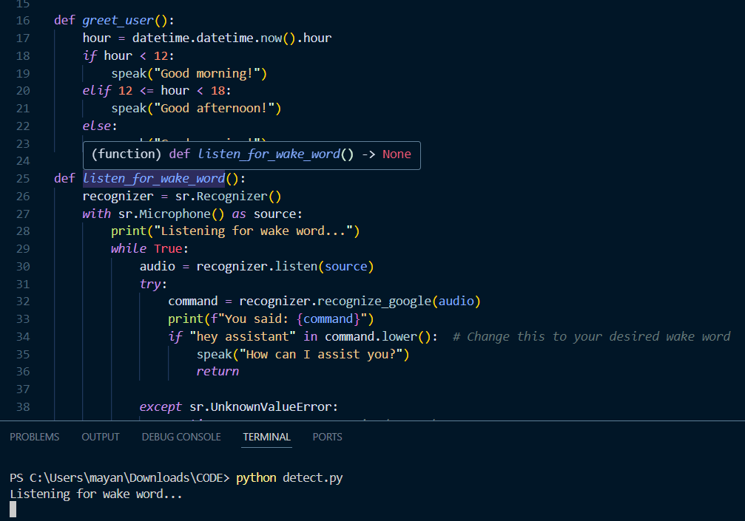
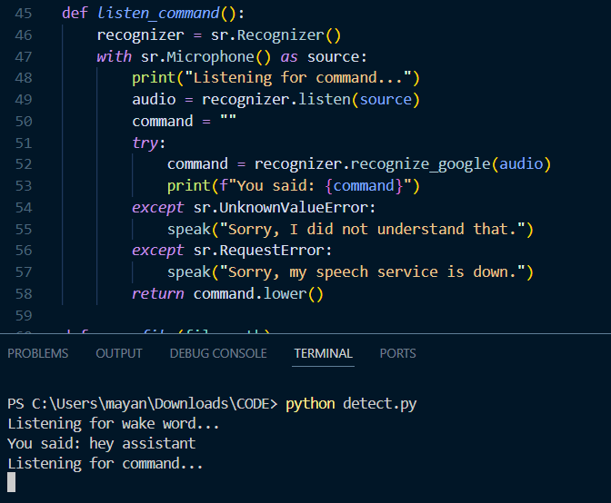
Implementation:
TASK 1:
TASK 2:

Slide 7
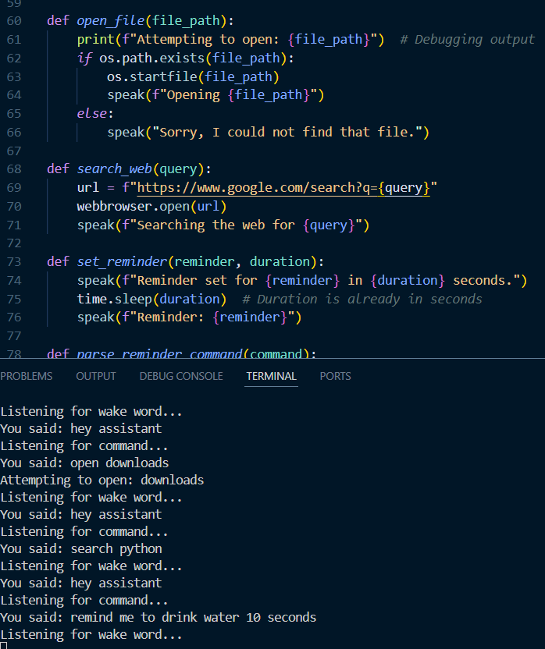

TASK 3:
TASK 4:

Slide 8
Conclusion and Future Scope:
In conclusion, the voice-activated personal assistant is a valuable tool that greatly helps visually impaired individuals by making daily tasks easier and promoting independence. By allowing users to interact with technology through voice commands, it simplifies activities like setting reminders, searching for information, and controlling smart devices. Looking ahead, there are many exciting possibilities for improvement. We can add features such as text recognition to read printed materials, live translation for communication in different languages, and object detection to help users navigate their surroundings more safely. Additionally, collaborating with transportation services can enhance travel experiences, while integrating with smart home technologies can create a more connected and user-friendly environment. Overall, this project has the potential to significantly improve the quality of life for visually impaired individuals, making their daily routines more manageable and enjoyable.

